Slide 1
E-commerce Fraud Detection
Dr. Jie Liu
Aug 12, 2022

Slide 2
Business Problem
The global ecommerce
Growth in global eCommerce losses 2020-2021 is 18%.
e-commerce losses with online payment fraud is about 20 billion (USD) globally in 2021.
e- commence sales
(billion US dollars)

Slide 3
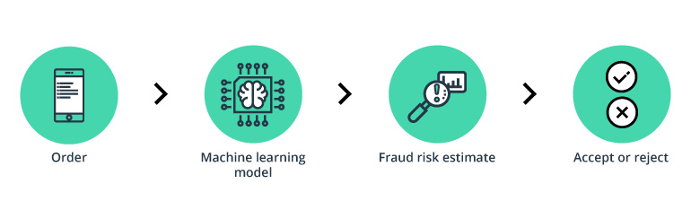
Model for Online Fraud Detection
Faster
Efficient
Real Time.

Slide 4
Exploratory Data Analysis
Data:
Fraud data:
user_id, signup_time, purchase_time, purchase_value, device_id, source, browser, sex, age, ip_address, class.
1378376 records.
Ip_country data:
Lower_bound_ip_address, upper_bound_ip_address.
138846 records.
ip_address
country

Slide 5
Imbalanced Fraud Dataset
user_id | signup_time | purchase_time | purchase_value | device_id | source | browser | sex | age | ip_address | class
22058 | 2015-02-24 22:55:49 | 2015-04-18 02:47:11 | 34 | QVPSPJUOCKZAR | SEO | Chrome | M | 39 | 7.327584e+08 | 0
338149 | 2015-08-06 22:15:13 | 2015-09-14 10:41:05 | 24 | VLHGCDPFCICDA | SEO | Chrome | F | 33 | 3.432126e+09 | 1
0: Normal, 1: Fraud

Slide 6
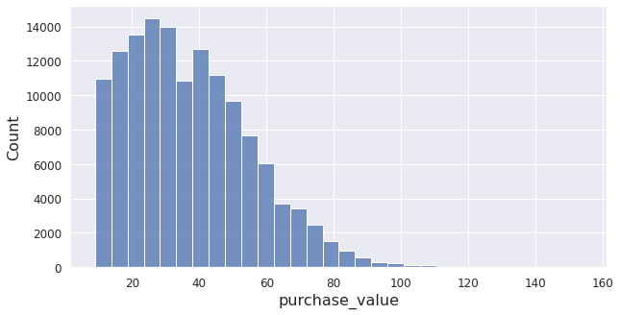
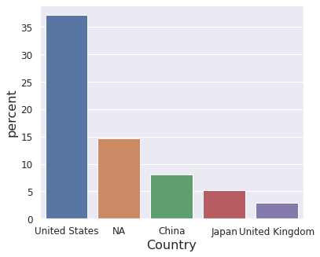
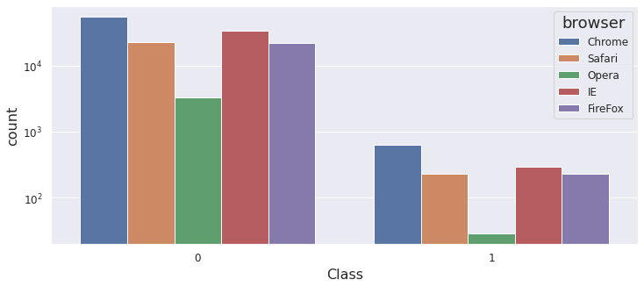
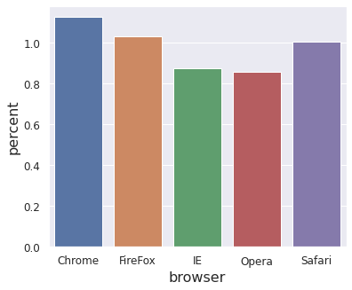
Data overview
Small-value purchases
180 countries in the fraud dataset, in which fraud was found in 79 countries.
Five browser (chrome, safari, opera, IE, Firefox)

Slide 7
Feature Engineering for Machine Learning
New features:
Interval_after_signup: purchase_time – signup_time
Signup_days_of_year
Signup_second_of_day
Purchase_days_of_year
Purchase_second_of_day
Data processing
Normalization

Slide 8
Model Performance
The balance between the fraud detection and normal purchase mark.
Prediction
Prediction
Prediction
 | Normal | Fraud
Normal | 27389 | 0
Fraud | 142 | 145
 | Normal | Fraud
Normal | 27389 | 243
Fraud | 132 | 155
 | Normal | Fraud
Normal | 4506 | 22883
Fraud | 16 | 271
Actual
Business revenue
Customer satisfaction
High detection of real fraud
243 * $ 35 * 10% = $850.50
(155 – 145) * $ 35 = $350.00
($ 35: median purchase value)

Slide 9
Fraud Red Flags
Short interval between signup and purchase
Big number of order with same device
Early purchase day of year
6x10⁶
3x10⁶
Interval time (s)
Fraud percentage
Purchase day of year
Device_id shared

Slide 10
Model Implementation
Score predicted by model
0
1 - 6
7 - 10
safe
investigation
declined
98.45% 1.03% 0.52%

Slide 11
Future improvement
More data
Model hyperparameter tune
More information
Website
Pay method
email (registration time)
Delivery method
Discount
ip address and bill address

